Slide 1
Handling Rejection Mark 6:1-13 Zhi Hong
Preached for Dr. Rick Griffith, Singapore Bible College www.biblestudydownloads.com

Slide 2
Non-Believer Family

Slide 3
Are You Ashamed of Rejection?

Slide 4
What do you normally do when you face rejection?
Will you give up or you will continue to preach by trusting in Christ?
What does it mean to you to trust in Christ even when you are rejected?

Slide 5
Mark 6:1-13
How do you handle rejections when you preaching the Word of God?
Do not be ashamed of the rejection for the Gospel (6:1-6)
Jesus faced rejection from his hometown people.

Slide 6
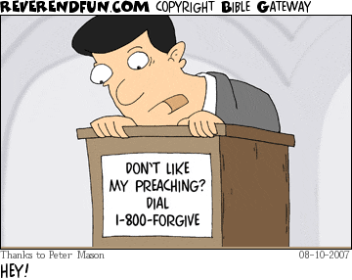
When a young pastor back to his home church.

Slide 7
B. Rejections did not cause Jesus stop to preach.
“And He amazed their lack of faith. Then Jesus went around teaching from village to village.”
Mark 6:6

Slide 8
Testimony of Kyon Jun Soon

Slide 9
Do not be discouraged to preach God’s word (7-13)

Slide 10
We are called to preach the word of God
“Calling the twelve to him, he sent them out two by two and gave them authority over evil spirits.”
Mark 6:7

Slide 11
Preaching the gospel is not ashamed.
“And if any place will not welcome you or listen to you, shake the dust off your feet when you leave, as a testimony against them.”
Mark 6:11

Slide 12
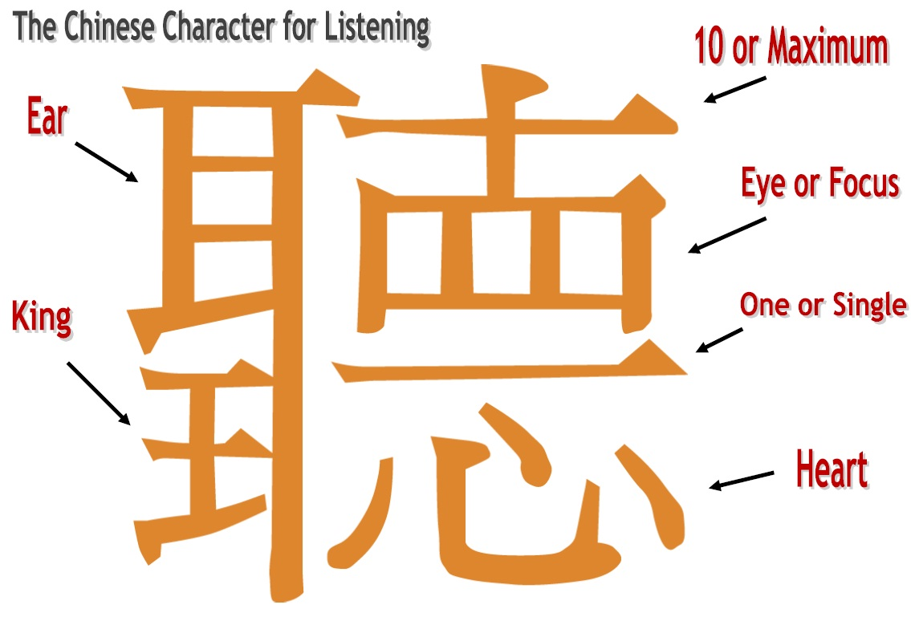
The gospel is for those who hears and responds.
“Then Jesus said, ‘He who has ears to hear, let him hear.’”
Mark 4:9

Slide 13
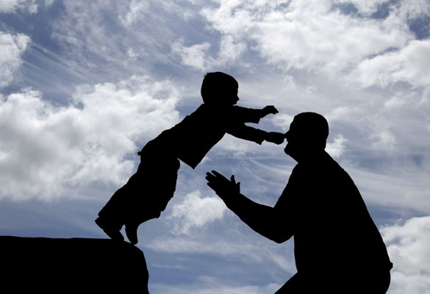
We preach with the power of God.
Faith leads to trust in Christ.
A small boy’s simple faith
God helps us in preaching His word.

Slide 14
Are You Ashamed of Rejection for the Word of God?

Slide 15
Conclusion
Trust Christ to help you preach God’s word even when you are rejected.
Rejections may face but it cannot stop us to preach the word with confidence for Christ empowers us.

Slide 16
Do not be ashamed for the rejection of the Gospel (6:1-6)
Do not be discouraged to preach God’s word (6:7-13)

Slide 17
Black

Slide 18
NT Sermons link at biblestudydownloads.com
Get this presentation and script for free!

